Slide 1
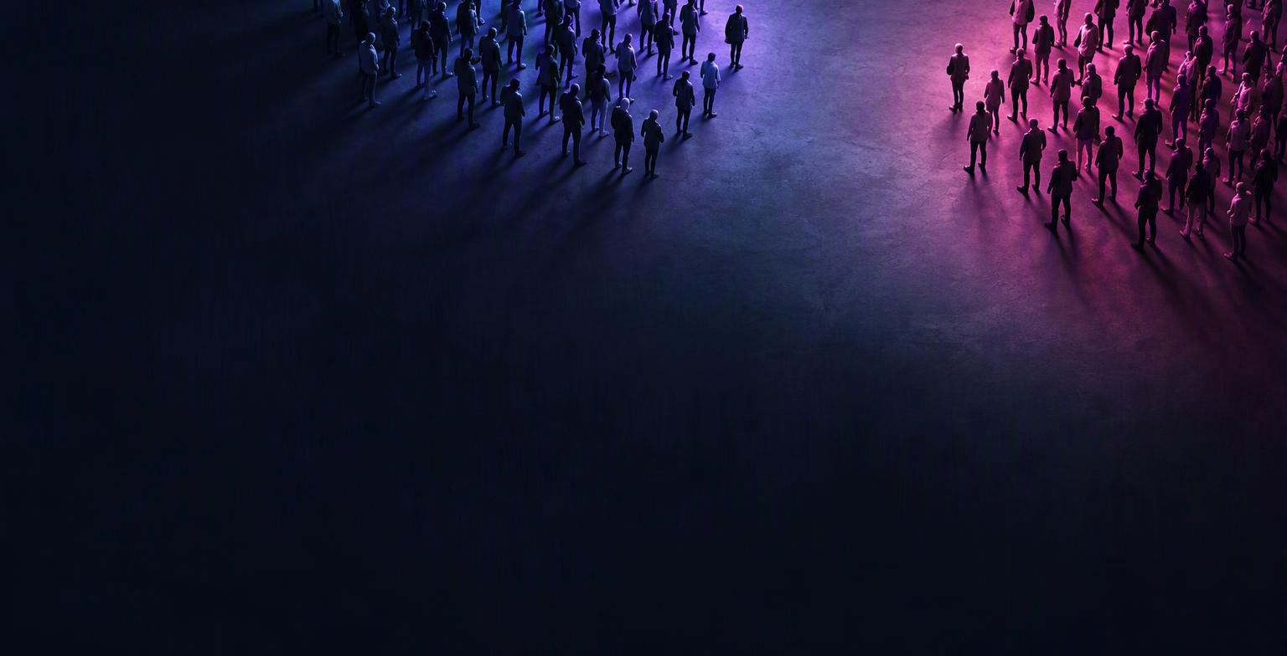
Has polarization increased?
Karri Lumivirta, Janne Tompuri, Maarit Vilen
[Sources]
Illustration: AI-generated, 12 October 2026. Conceptual illustration, not an actual event, document, or data visualization.
Notes:
[Sources]
Background: AI-generated conceptual illustration, 12 October 2026. Not an actual event.
[/Sources]

Slide 2

Polarization – what and why
Understanding polarization matters for voters and democracy.
We analysed parliamentary debates to assess whether polarization is increasing.
[Sources]
Illustration: AI-generated, 12 October 2026. Conceptual illustration, not an actual event, document, or data visualization.
Notes:
[Sources]
Illustration: AI-generated, 12 October 2026. Conceptual illustration, not an actual event, document, or data visualization.
[/Sources]

Slide 3

The method
Our data consisted of 130,000 plenary speeches from 2015 to 2026.
We used AI (Claude) for coding the model and for coding the analysis.
Used model was multinominal logistic regression.
We used the same methodology as Simola et al. (2023) with some additional analysis and inclusion of election data.
130.00 plenary speechers, 2015-2026
[Sources]
Illustration: AI-generated, 12 October 2026. Conceptual illustration, not an actual event, document, or data visualization.
Notes:
[Sources]
Illustration: AI-generated, 12 October 2026. Conceptual illustration, not an actual event, document, or data visualization.
[/Sources]

Slide 4

Logic of the model
We developed a model which is trying to predict the party of the speaker based on the language the politician is using.
Easier predictions over time indicate greater differences in party language.
1 in 3 correct guesses today, up from 1 in 4
[Sources]
Illustration: AI-generated, 12 October 2026. Conceptual illustration, not an actual event, document, or data visualization.
Notes:
[Sources]
Illustration: AI-generated, 12 October 2026. Conceptual illustration, not an actual event, document, or data visualization.
[/Sources]

Slide 5
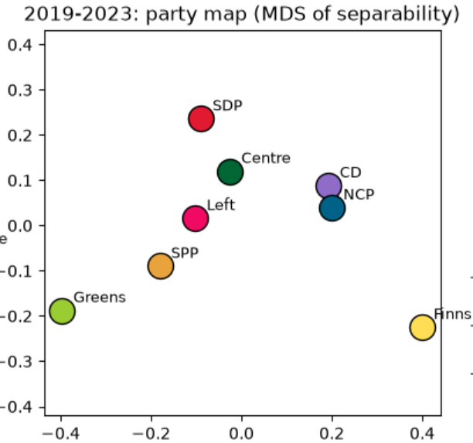
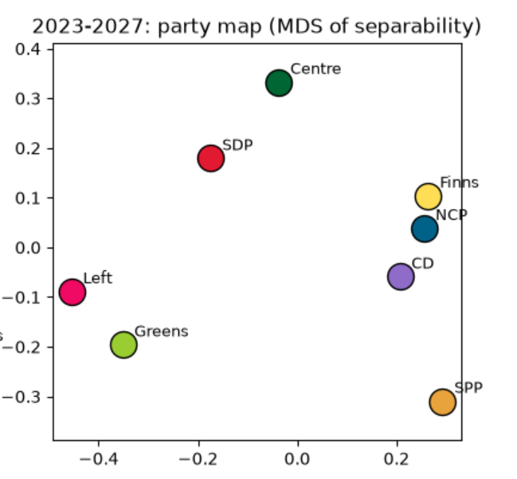
Preliminary results

Slide 6

Worth of noting
Parties may discuss different topics: immigration for the True Finns, climate for the Greens.
Three governments across three terms complicate separating trends from government effects.
The study measures language, not opinions.
A century-long study places peak division in the 1970s. Recent data show Finnish parties moving further apart into two blocs.
[Sources]
Illustration: AI-generated, 12 October 2026. Conceptual illustration, not an actual event, document, or data visualization.
Notes:
[Sources]
Illustration: AI-generated, 12 October 2026. Conceptual illustration, not an actual event, document, or data visualization.
[/Sources]

Slide 7

Thank you!
Link to our blog:
https://jtompuri.github.io/data-science-mini-project/
AI (Microsoft copilot) has been used to improve the layout and language of the slides.
References: Simola, Salla, Jeremias Nieminen, and Janne Tukiainen. 2023. “A Century of Partisanship in Finnish Political Speech.” Aboa Centre for Economics Discussion Paper, no. 160.
[Sources]
Illustration: AI-generated, 12 October 2026. Conceptual illustration, not an actual event, document, or data visualization.
Notes:
[Sources]
Illustration: AI-generated, 12 October 2026. Conceptual illustration, not an actual event, document, or data visualization.
[/Sources]

